Slide 1
Advantages of Decision Tree:
• It can be used for both Regression and Classification problems.
• Decision Trees are very easy to grasp as the rules of splitting is clearly mentioned.
• Complex decision tree models are very simple when visualized. It can be understood just by visualizing.
• Scaling and normalization are not needed.
Disadvantages of Decision Tree:
• Probability of overfitting is very high for Decision Trees.
• It takes more time to train a decision tree model than other classification algorithms.

Slide 2
Important hyperparameters
Parameters
* criterion : string, optional (default="gini")
The function to measure the quality of a split. Supported criteria are
"gini" for the Gini impurity and "entropy" for the information gain.
* max_depth : int or None, optional (default=None)
The maximum depth of the tree. If None, then nodes are expanded until
all leaves are pure or until all leaves contain less than
min_samples_split samples.
* min_samples_split : int, float, optional (default=2)
The minimum number of samples required to split an internal node:
- If int, then consider `min_samples_split` as the minimum number.
- If float, then `min_samples_split` is a fraction and
`ceil(min_samples_split * n_samples)` are the minimum
number of samples for each split.

Slide 3
Important hyperparameters
* min_samples_leaf : int, float, optional (default=1)
The minimum number of samples required to be at a leaf node.
A split point at any depth will only be considered if it leaves at
least ``min_samples_leaf`` training samples in each of the left and
right branches. This may have the effect of smoothing the model,
especially in regression.
- If int, then consider `min_samples_leaf` as the minimum number.
- If float, then `min_samples_leaf` is a fraction and
`ceil(min_samples_leaf * n_samples)` are the minimum
number of samples for each node.

Slide 4
Important hyperparameters
* max_features : int, float, string or None, optional (default=None)
The number of features to consider when looking for the best split:
- If int, then consider `max_features` features at each split.
- If float, then `max_features` is a fraction and
`int(max_features * n_features)` features are considered at each
split.
- If "auto", then `max_features=sqrt(n_features)`.
- If "sqrt", then `max_features=sqrt(n_features)`.
- If "log2", then `max_features=log2(n_features)`.
- If None, then `max_features=n_features`.
Note: the search for a split does not stop until at least one
valid partition of the node samples is found, even if it requires to
effectively inspect more than ``max_features`` features.

Slide 5
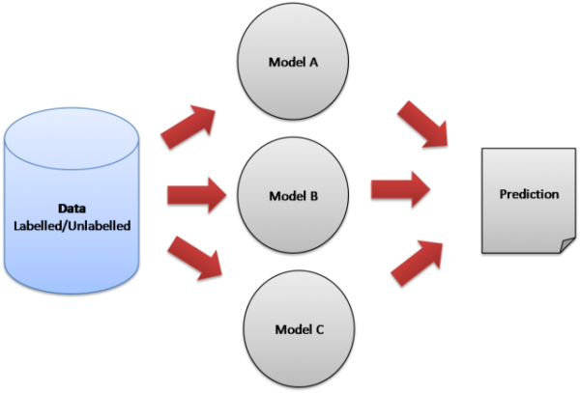
Ensemble Learning
Ensemble learning is the process by which multiple models, such as classifiers or experts, are strategically generated and combined to solve a particular problem.

Slide 6
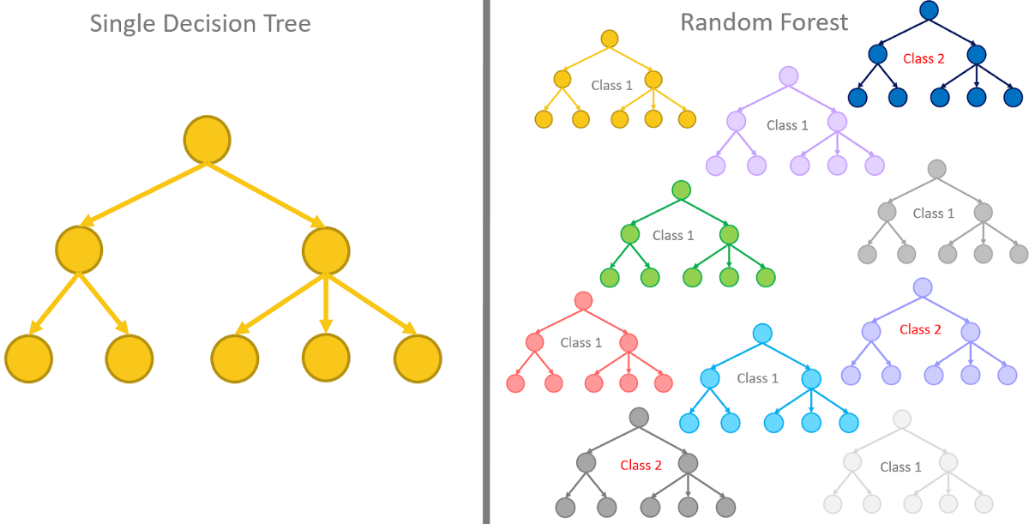
Random Forest
Its is part of Ensemble Learning in which we combine multiple decision Tree models for prediction.We have studied that decision trees tend to overfit the data. So Ensemble technique becomes a very good solution for decreasing the variance in a decision tree.

Slide 7
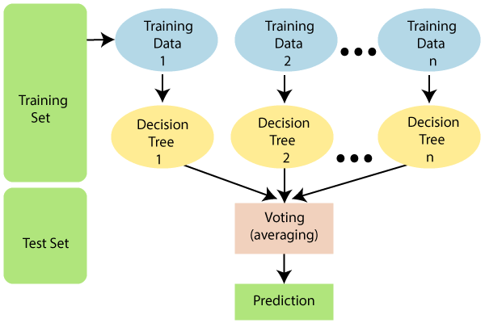
Let’s understand how algorithm works for a random forest model
Random Sample creation from training dataset
Training of the DT on those random sample
Aggregating the result

Slide 8
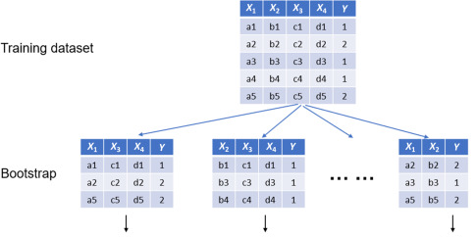
Random sampling Row sampling + col sampling with replacement

Slide 9
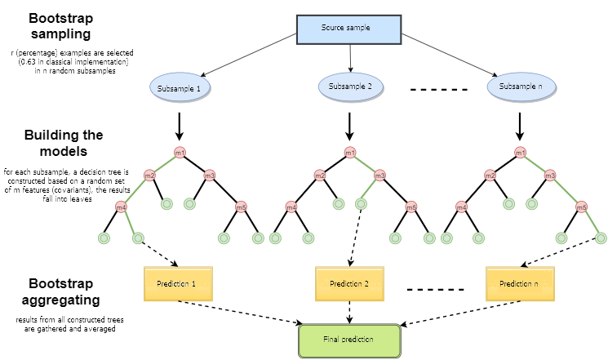
Training

Slide 10
Advantages and Disadvantages of Random Forest:
1) It can be used for both regression and classification problems.
2) Since base model is a tree, handling of missing values is easy.
3) It gives very accurate result with very low variance.
4) Results of a random forest are very hard to interpret in comparison with decision trees.
5) High computational time than other respective models.
Random Forest should be used where accuracy is up utmost priority and interpretability is not very important. Also, computational time is less expensive than the desired outcome

Slide 11
END TO END Deployment project

Slide 12
Getting ready for Deployment
PyCharm : https://www.jetbrains.com/pycharm/download/#section=windows
Postman : https://www.postman.com/downloads/
Create free AWS Account : https://aws.amazon.com/free/
Open Anaconda Prompt in administrative mode
Create new environment : conda create -n deployment python=3.6.9
Activate environment : activate deployment
Install basic library
Install flask : pip install flask
Pickle : pip install pickle-mixin
Sklearn : pip install -U scikit-learn
Pandas : pip install pandas

Slide 13

Application Programming Interface (API)
An application programming interface is a computing interface that defines interactions between multiple software applications or mixed hardware-software intermediaries. It defines the kinds of calls or requests that can be made, how to make them, the data formats that should be used, the conventions to follow, etc

Slide 14
Flask
Flask is an API of Python that allows us to build up web-applications. It was developed by Armin Ronacher.
Flask like any other web application development framework, utilizes the HTTP methods. Let’s see the most used methods:
a) GET: The GET method means retrieve whatever information (in the form of an entity) is identified by the Request-URI. If the Request-URI refers to a data-producing process, it is the produced data which shall be returned as the response.
b) POST: The POST method is used to request that the origin server accept the entity enclosed in the request as a new subordinate of the resource identified by the Request-URI in the Request-Line. POST is designed to allow a uniform method to cover the following functions:

Slide 15
Used car price prediction with Deployment
To predict used cars market value can help both buyers and sellers.
Applied Various regression machine learning algorithms and also performed hyperparameter tunning
Deployment on AWS Beanstalk

Slide 16

AWS
Amazon Web Services is a subsidiary of Amazon providing on-demand cloud computing platforms and APIs to individuals, companies, and governments, on a metered pay-as-you-go basis.

Slide 17
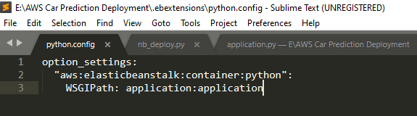
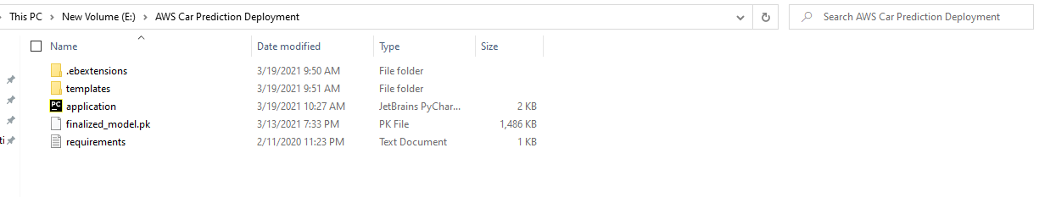
Creating files for deployment
Create requirement.txt for Project
Got to the Project environment Anaconda prompt and Execute pip freeze > requirements.txt
Create folder “.ebextensions”
Make a new file python.config in .ebextensions folder.(you can also use notepad for creating config file)

Slide 18
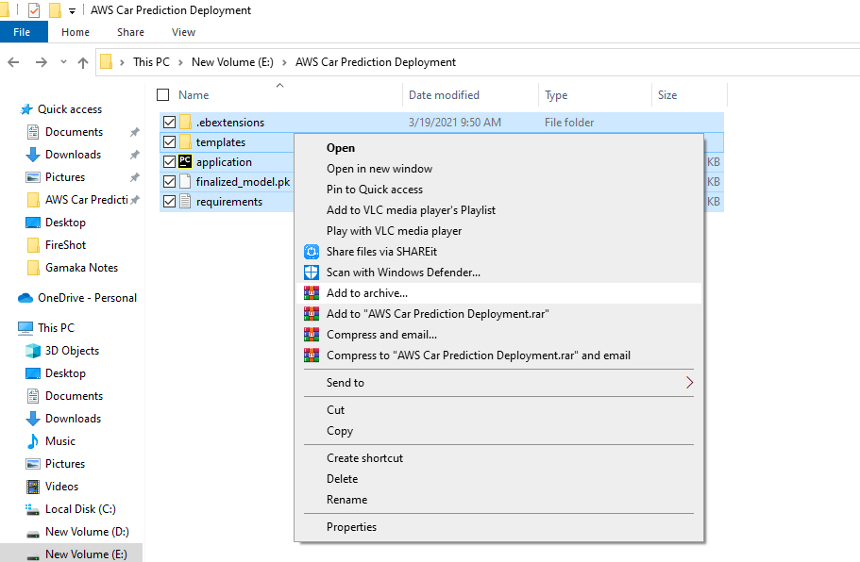
ZIP file for deployment

Slide 19
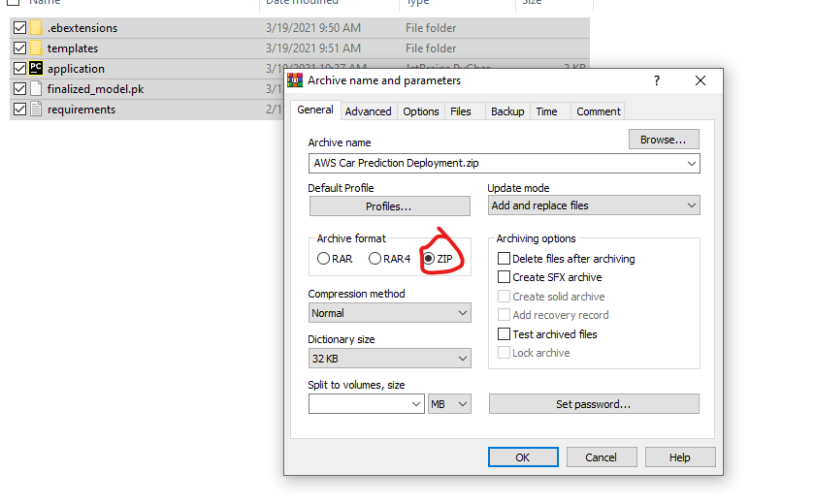

Slide 20
For Deployment process we are going to use for Elastic Beanstalk
AWS Elastic Beanstalk
End-to-end web application management.
AWS Elastic Beanstalk is an easy-to-use service for deploying and scaling web applications and services developed with Java, .NET, PHP, Node.js, Python, Ruby, Go, and Docker on familiar servers such as Apache, Nginx, Passenger, and IIS.

